Slide 1
Portfolio Optimization: Analyzing Strategies for Maximum Returns
Anuj Gupta (21d070014)
Harsh Shah (210100063)
Soham Rahul Inamdar (210100149)
Shounak Das (21D070068)
Sahil Wani (210070070)

Slide 2
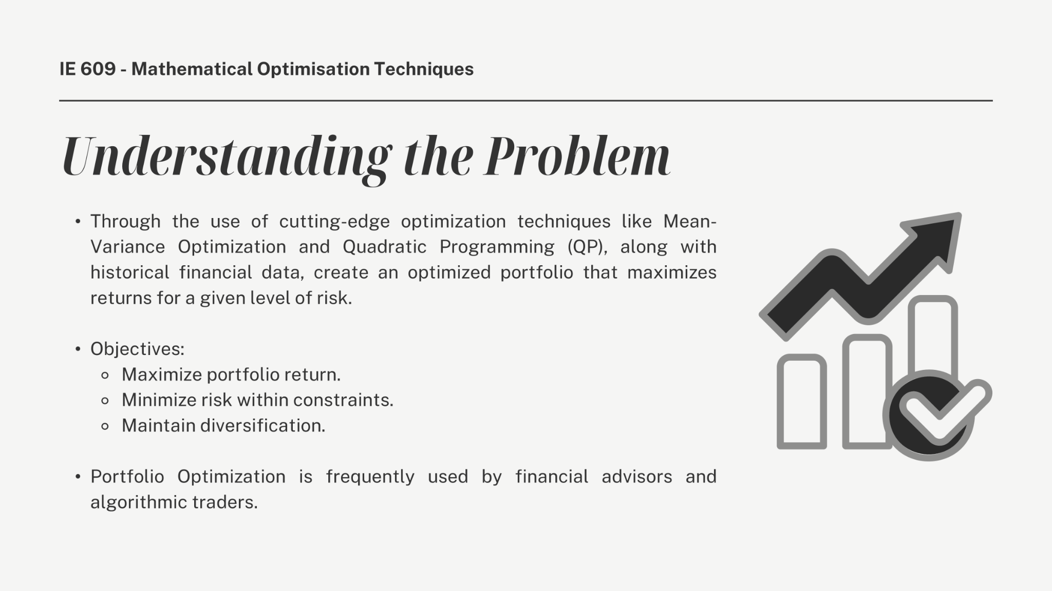

Slide 3
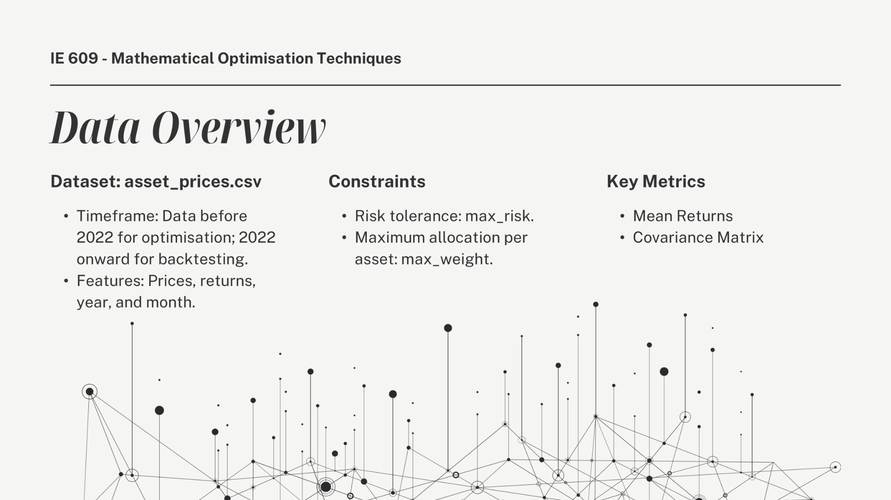

Slide 4
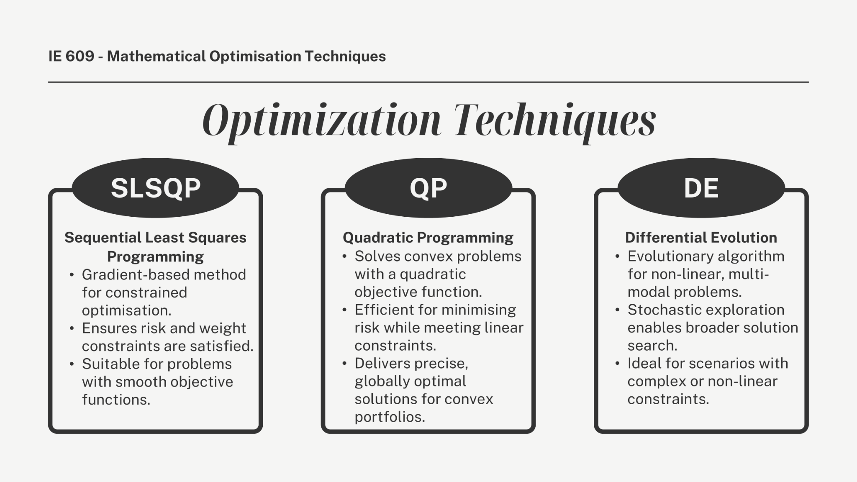

Slide 5
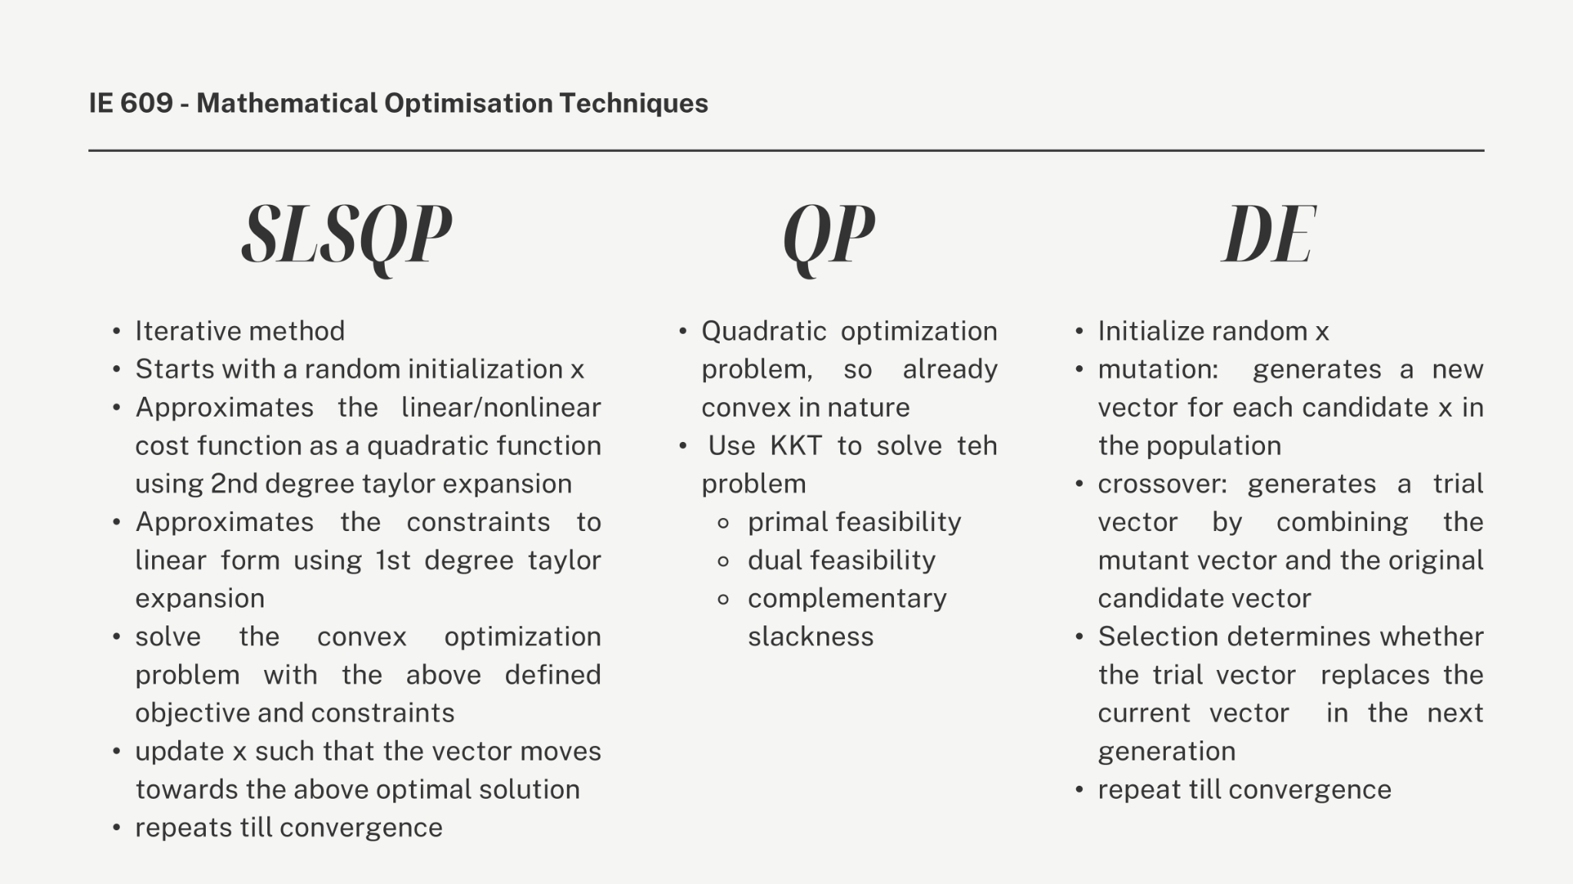

Slide 6
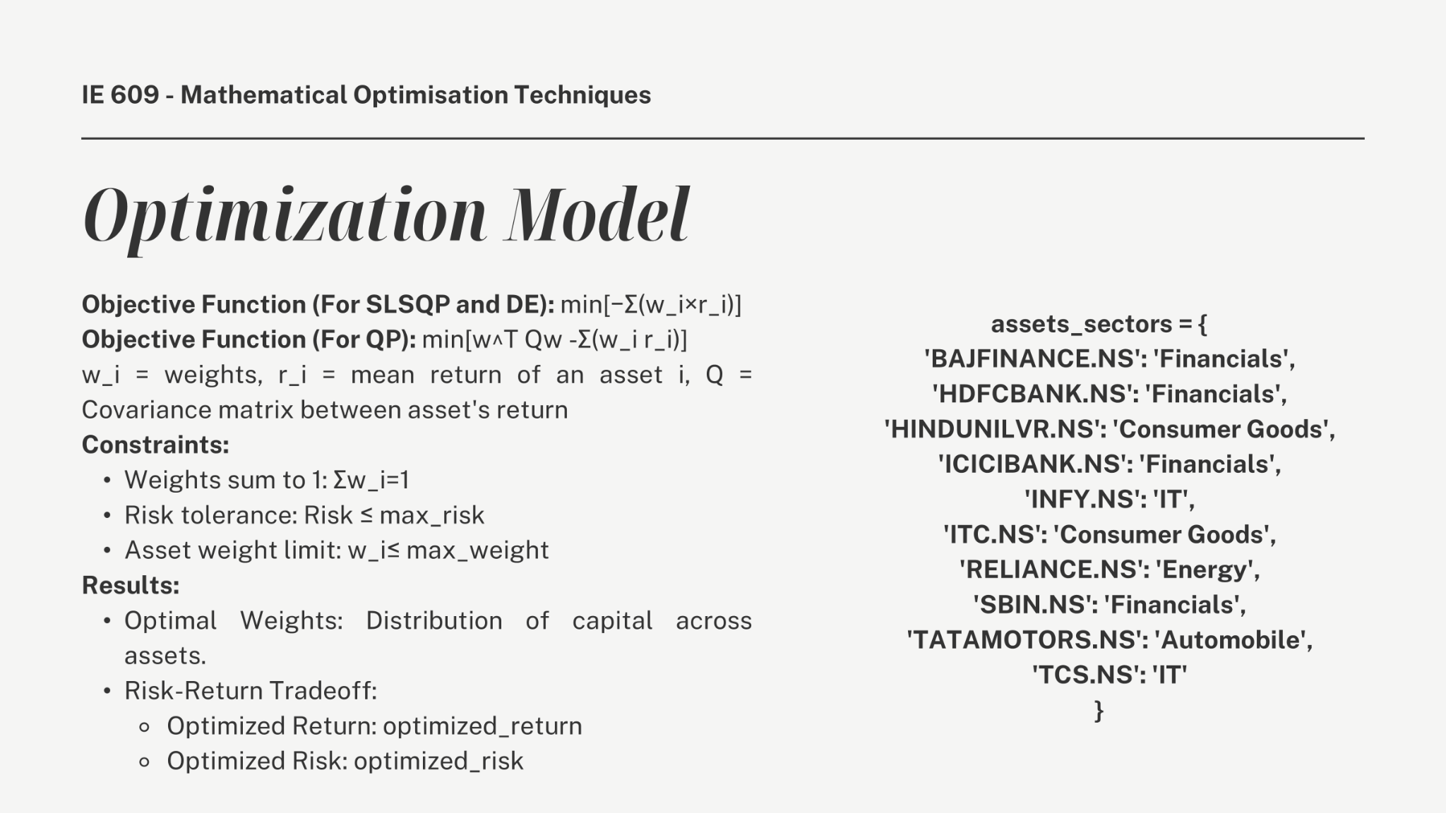

Slide 7
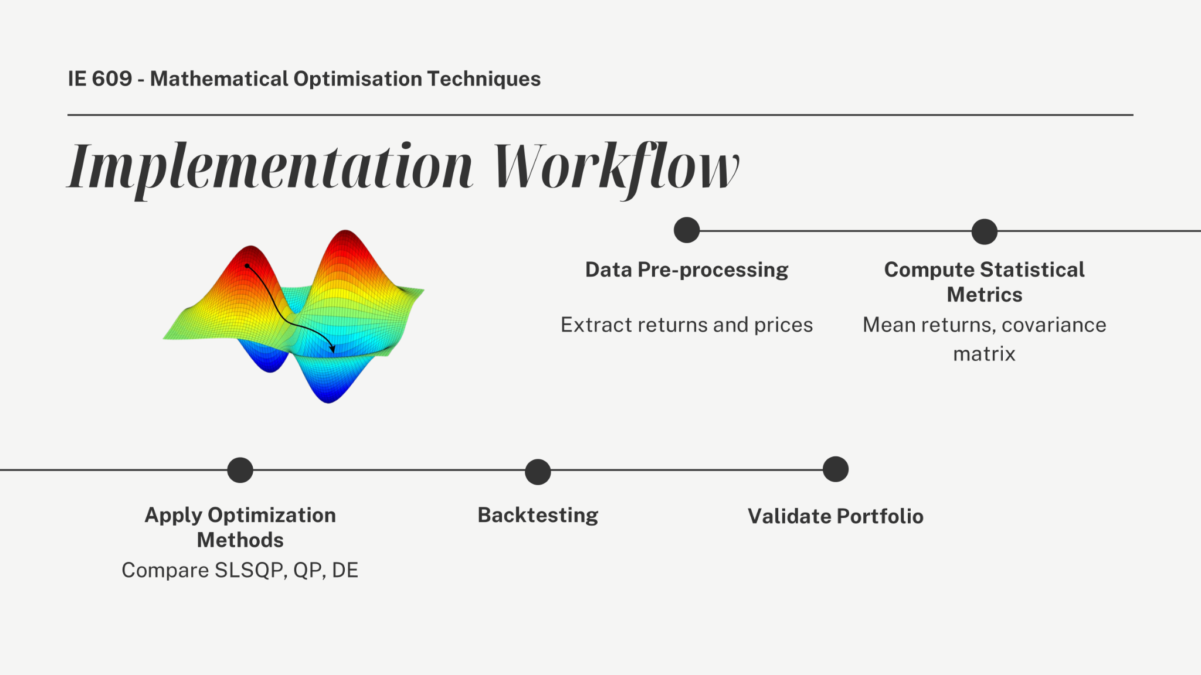

Slide 8
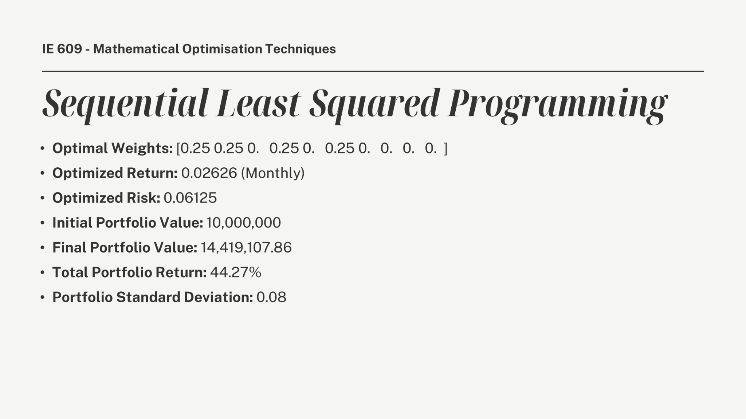

Slide 9
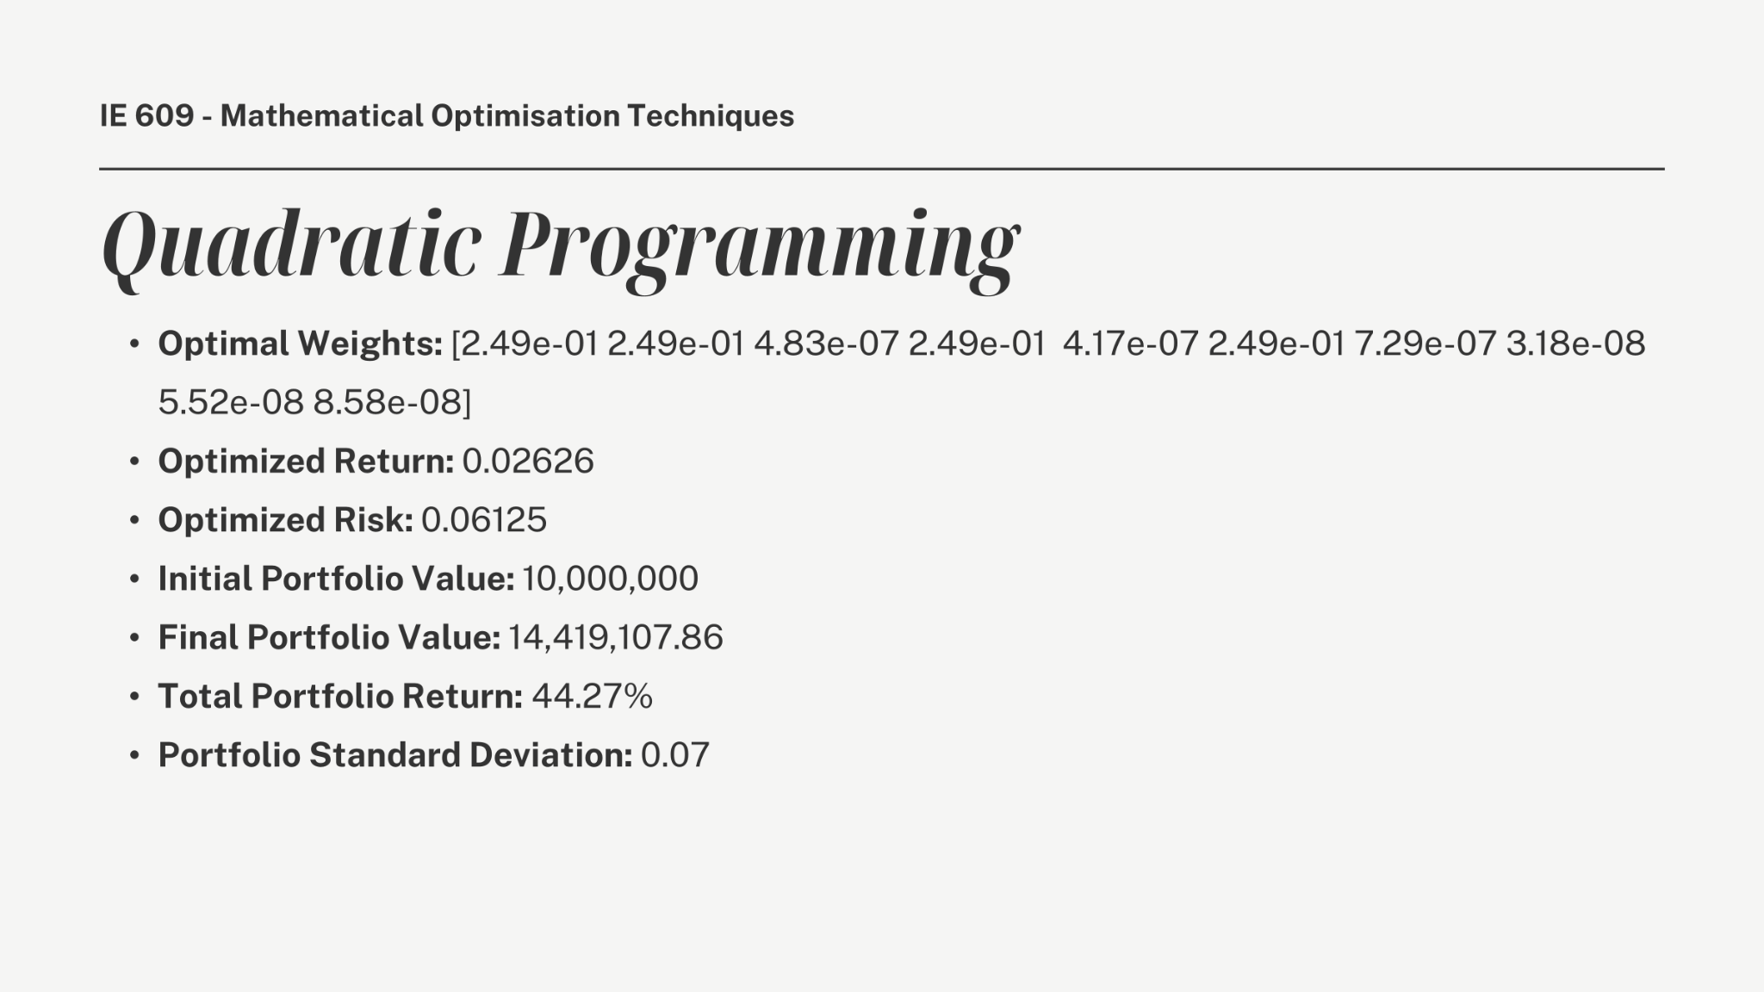

Slide 10
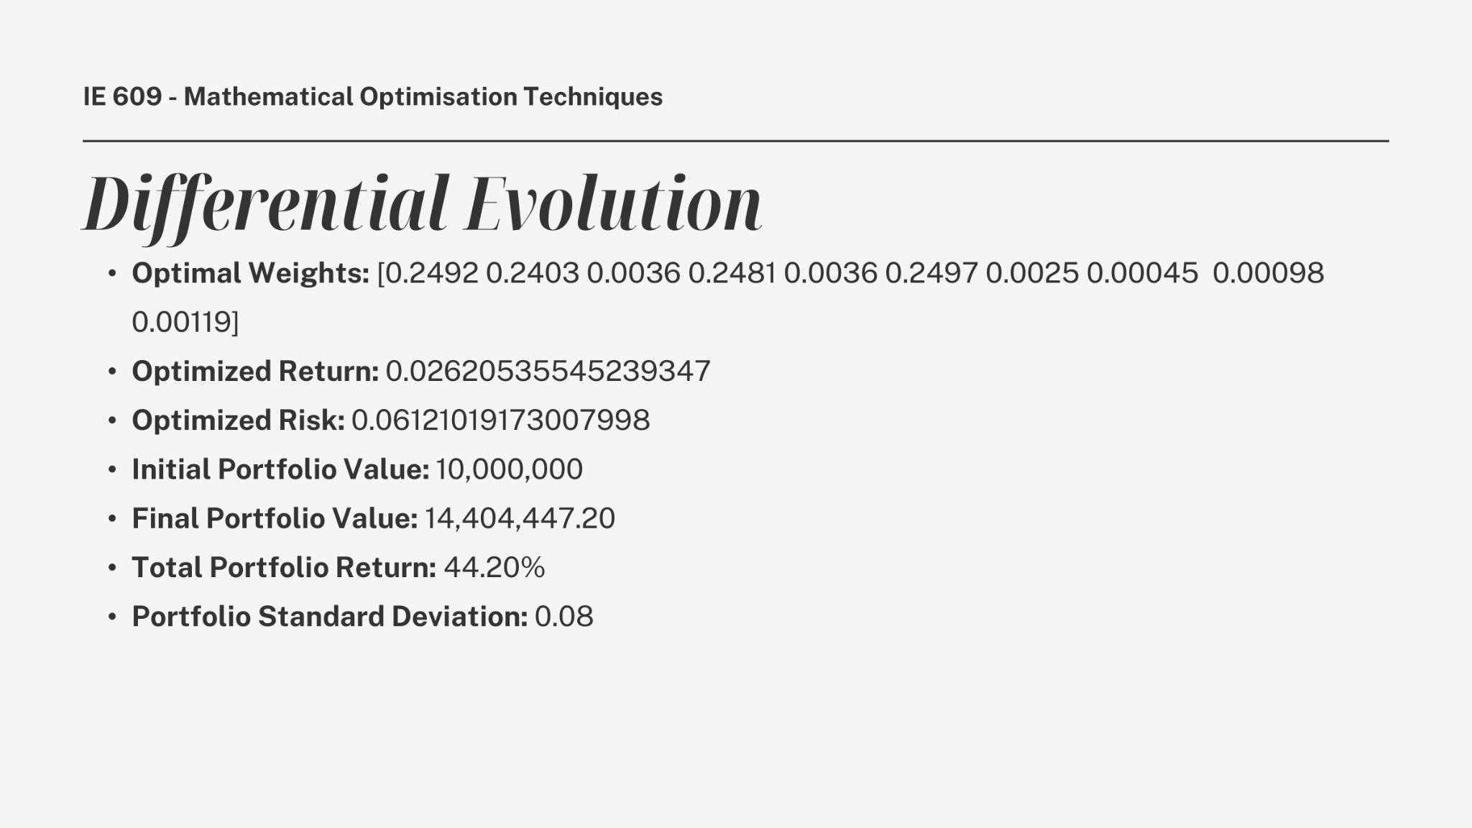

Slide 11
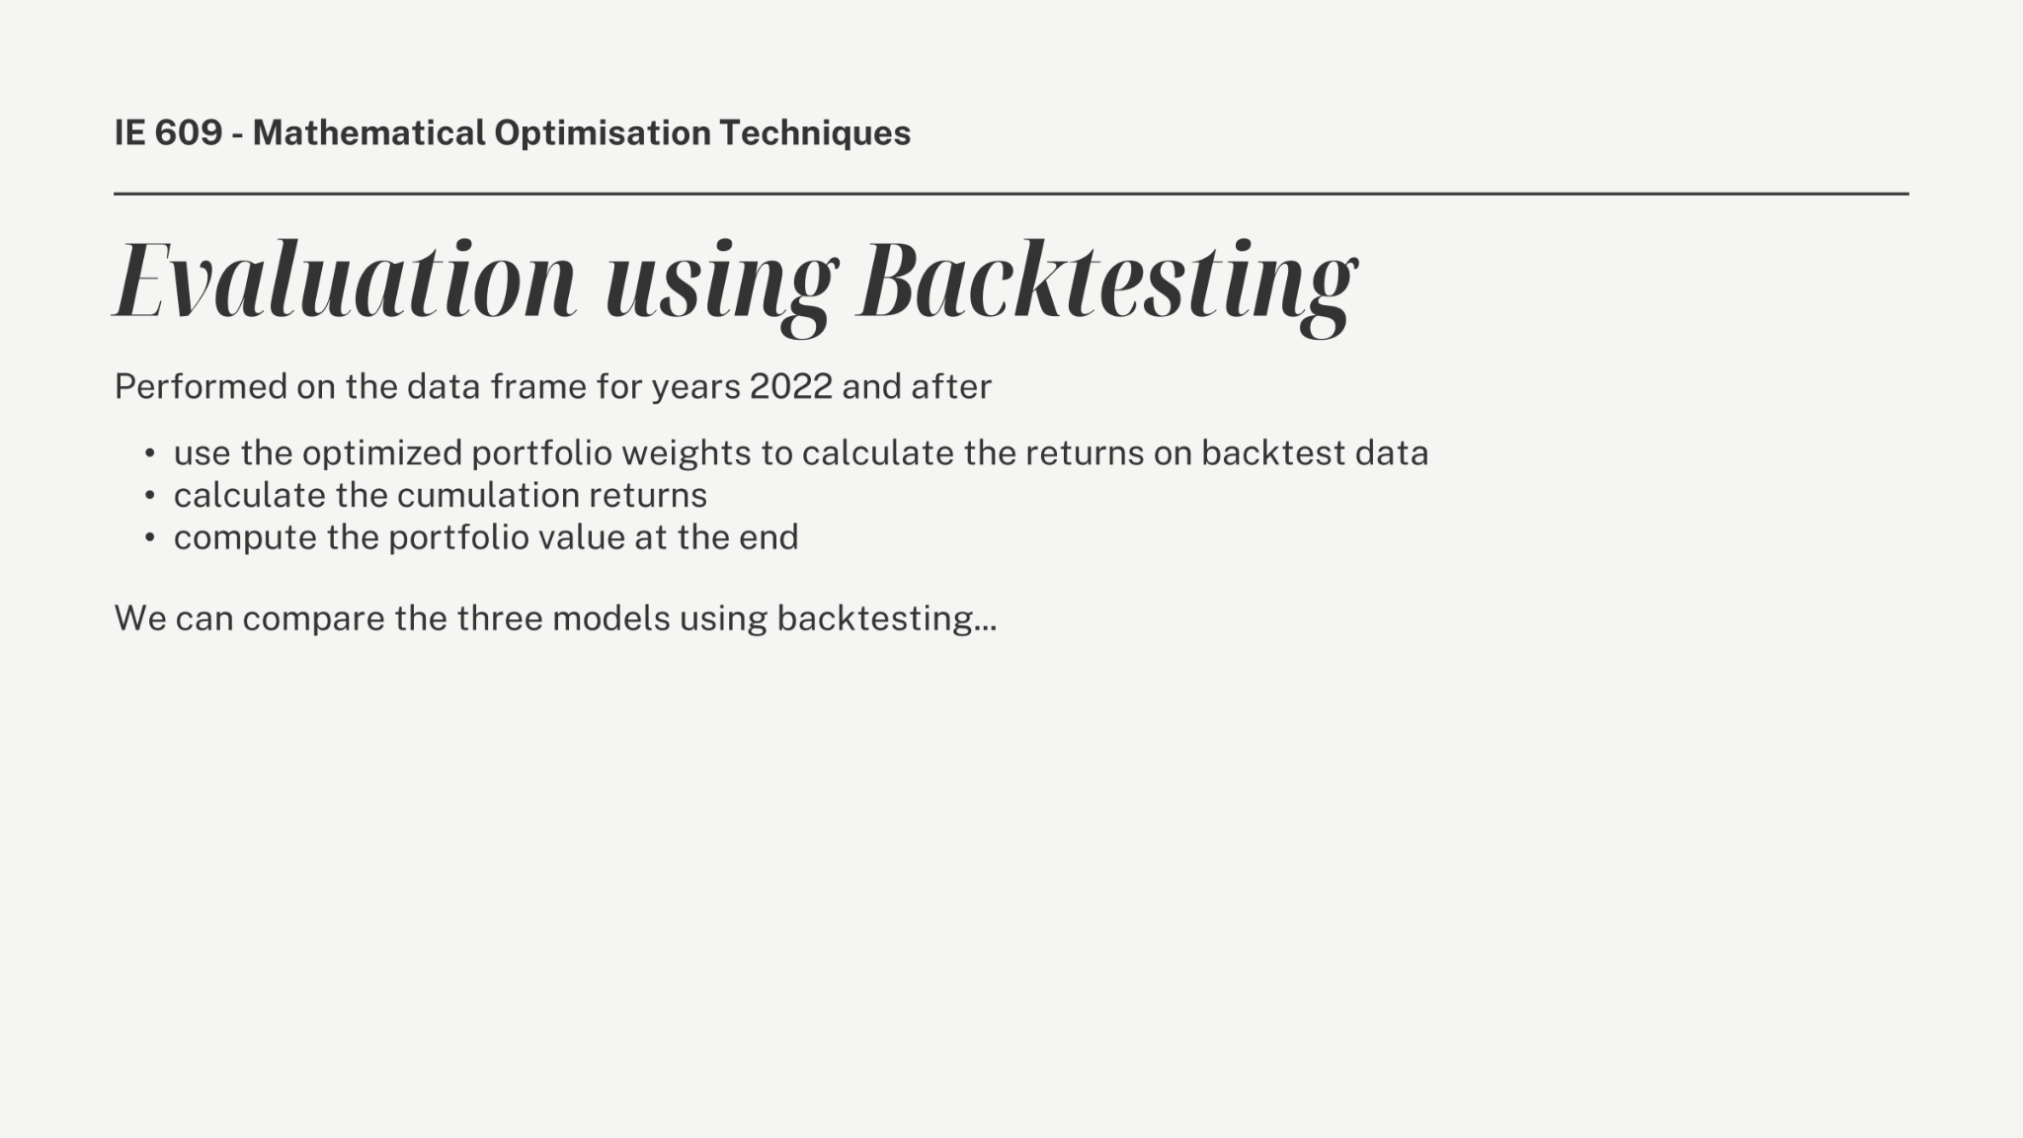

Slide 12
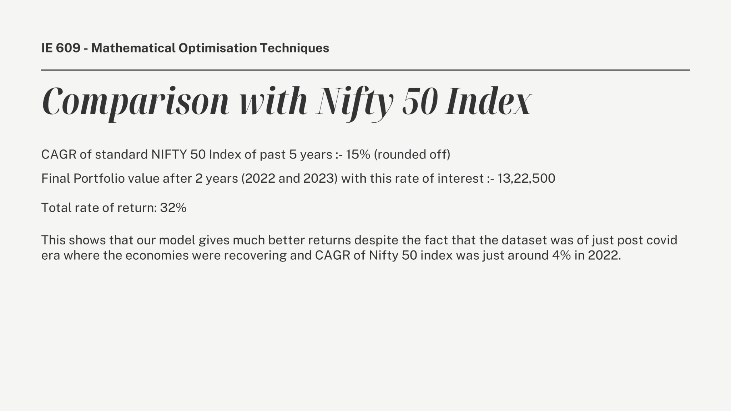

Slide 13
Different Risk Measures
What is risk measure ?
Quantifies potential financial loss.
Critical for portfolio optimization and risk management.
Common Risk Measures:
Variance (Traditional measure).
Value at Risk (VaR).
Conditional Value at Risk (CVaR).

Slide 14
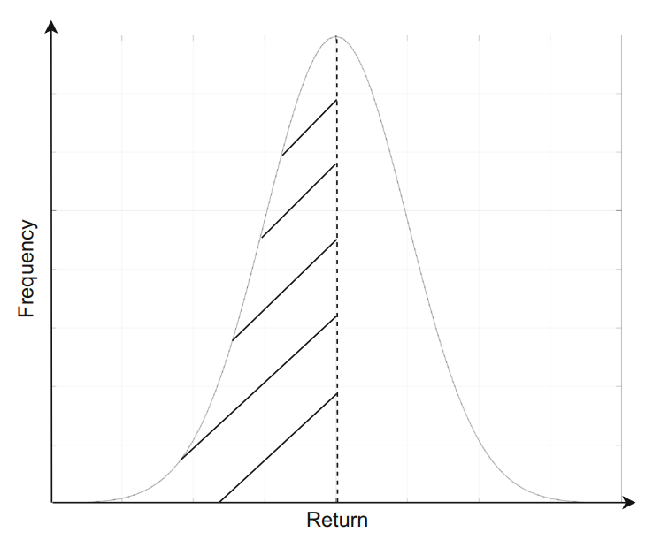
Variance as a Risk Measure
Measures the dispersion of asset returns around the mean
High variance means higher risk only under the assumption of normal distribution of return
Variance can barely depict the downside risk if return is not symmetric around the mean
Notes:
Downside risk refers to the probability that an asset or security will fall in price. It is the potential loss that can result from a fall in the price of an asset as a result of changing market conditions.

Slide 15
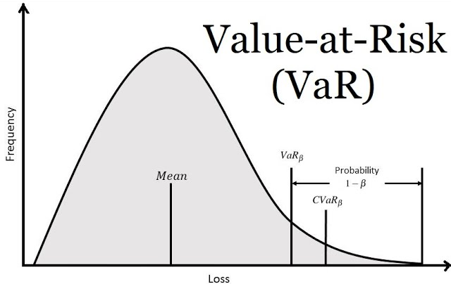
Introduction to VaR
Measures the maximum downside risk of a portfolio with a given confidence level.
For a specified probability measure ꞵ, the ꞵ-VaR of the portfolio is the lowest amount 𝛼 such that with probability ꞵ, the loss will not exceed 𝛼.
Ignores losses beyond the VaR threshold
Notes:
Suppose you are given a confidence level beta, then VaR gives you the minimum risk value where you can say with confidence value Beta, the loss won’t exceed that threshold.

Slide 16
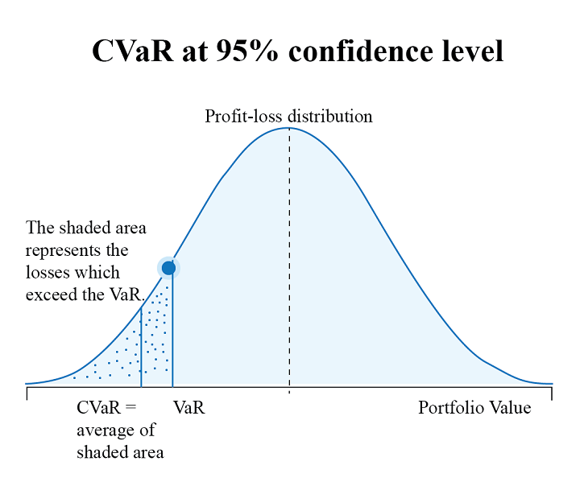
Introduction to CVaR
Measures the expected loss exceeding VaR
Complements VaR by accounting for tail risks
Better measure for extreme loss scenarios
Portfolios with low CVaR will have low VaR

Slide 17
Risk Measure | Description | Strengths | Limitations
Variance | Dispersion of returns around mean | Simple, widely used | Fails for asymmetrical distributions
VaR | Maximum loss at confidence level | Easy to interpret for investors | Ignores tail losses
CVaR | Expected loss beyond VaR | Captures tail risk, more robust | Computationally intensive

Slide 18
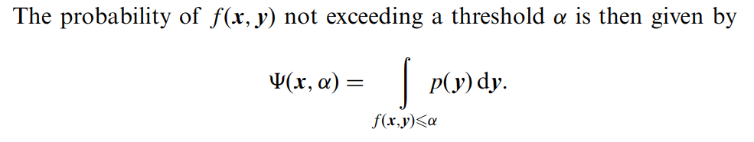
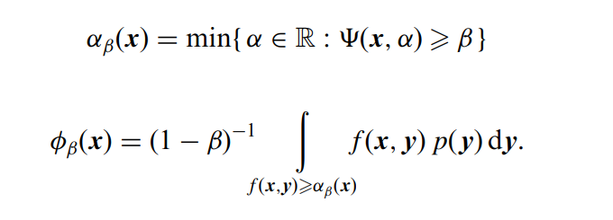
Mathematics of VaR and CVaR
Notes:
Let f(x,y) be the random variable denoting the loss associated with the decision variable x(what values of assets we will choose) and random vector y(uncertainty). The y denotes the randomness in the market and assumed to some probability distribution p(y) which is known apriori. Take alpha as certain threshold value, the Phi is the CDF of loss associated wrt to the decision variable x. It basically tells you prob(f(x,y)<=alpha). Var – Minimum alpha value where the probability of Phi is equal to Beta
CVaR – Conditional expectation values exceeding VaR

Slide 19
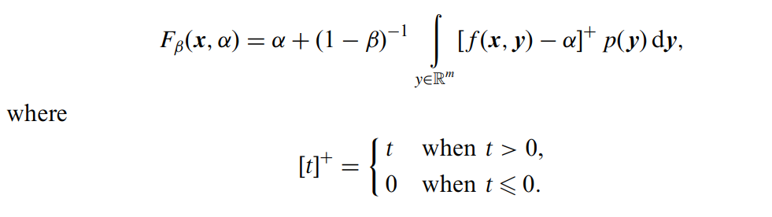
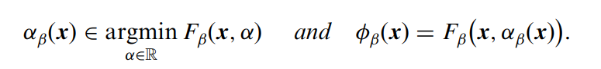

Slide 20
Results
Return: 20.7391
Final Portfolio Value: 12,073,915.01
Optimized Risk: 0.00157
Optimal Weights: [0.084, 0.163, 0, 0.204, 0, 0, 0.502, 0, 0.045, 0]
Value at Risk (VaR): 0.0439
Conditional Value at Risk (CVaR): 0.0450

Slide 21
CVaR over VaR
Coherence: CVaR satisfies key properties like subadditivity, convexity, and positive homogeneity; VaR often fails these criteria.
Optimization-Friendly: CVaR is convex and easier to optimize, unlike VaR, which can exhibit multiple local extrema.
Better Risk Capture: CVaR accounts for tail risk beyond the VaR threshold, offering a more complete view of extreme losses.

Slide 22
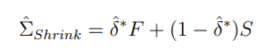
Covariance Matrix Robustness
Covariance matrices are critical in portfolio optimization, but raw estimates can be noisy and unstable, especially with limited data.
Robust methods improve stability and reduce overfitting, ensuring more reliable risk assessments.
Ledoit-Wolf Shrinkage
Shrinks towards a diagonal matrix to balance bias and variance.
Automatically determines optimal shrinkage intensity.
Consider the sample covariance matrix S and a highly structured estimator, denoted by F, then operational shrinkage estimator of the covariance matrix Σ is

Slide 23
Ledoit-Wolf VS OAS Shrinkage
Used in cases of low data-to-variable ratio
Ledoit-Wolf: Making the matrix less sensitive to noise and outliers
We don’t trust the data completely
Weighted average of calculated covariance matrix and a "basic" covariance matrix
The "basic" matrix assumes no relationships between stocks
Benefits
Stability
Better Predictions
Automatic Shrinkage

Slide 24
Ledoit-Wolf VS OAS Shrinkage
Used when the number of data points is small
Oracle Approximating Shrinkage
Idea : Combine Noisy matrix and simplified matrix
Minimizing error between estimated matrix and the true (unknown) covariance
We minimize a specific measure of error called the Frobenius norm
Benefits
Computationally efficient
Useful for Small Datasets
Reduces overfitting

Slide 25
Ledoit-Wolf VS OAS Shrinkage
Used when the number of data points is small
Main Goal : Making the matrix less sensitive to noise and outliers
We don’t trust the data completely
Ledoit-Wolf - weighted average of calculated covariance matrix and a "basic" covariance matrix
The "basic" matrix assumes no relationships between stocks
Benefits
Stability
Better Predictions
Automatic Shrinkage

Slide 26
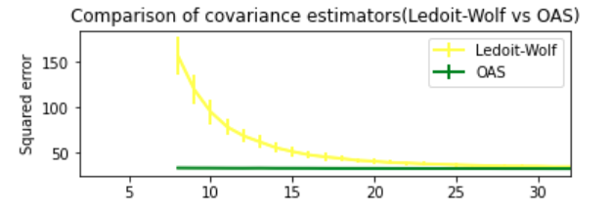
Comparison of Covariance Estimators (Ledoit-Wolf vs OAS)
Ledoit-Wolf shrinkage minimizes mean-squared error in covariance estimation and converges well for large samples, while OAS achieves faster convergence with smaller sample sizes by optimizing a Stein loss function.

Slide 27
THANK YOU !

